Slide 1


Lab 9
NN for XOR
With PyTorch 0.2.0_2
Sung Kim <hunkim+ml@gmail.com>
Code: https://github.com/hunkim/DeepLearningZeroToAll/

Slide 2
https://github.com/hunkim/DeepLearningZeroToAll/tree/master/pytorch
https://github.com/hunkim/DeepLearningZeroToAll/blob/master/pytorch/lab-06-1-softmax_classifier.py

Slide 3
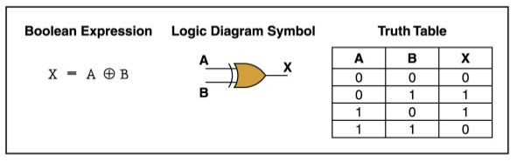
XOR data set
x_data = np.array([[0, 0], [0, 1], [1, 0], [1, 1]], dtype=np.float32)
y_data = np.array([[0], [1], [1], [0]], dtype=np.float32)
http://templ25.mandaringardencity.com/xor-gate-truth-table-2/

Slide 4
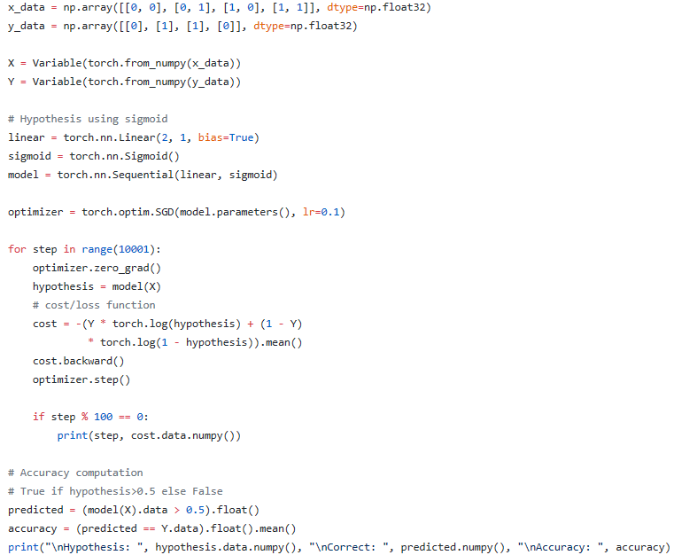
XOR with
logistic regression?
But
it doesn’t work
https://github.com/hunkim/DeepLearningZeroToAll/blob/master/pytorch/lab-06-1-softmax_classifier.py

Slide 5
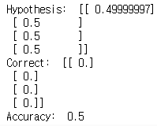
XOR with
logistic regression?
But
it doesn’t work!
https://github.com/hunkim/DeepLearningZeroToAll/blob/master/pytorch/lab-06-1-softmax_classifier.py

Slide 6
https://github.com/hunkim/DeepLearningZeroToAll/tree/master/pytorch
https://github.com/hunkim/DeepLearningZeroToAll/blob/master/pytorch/lab-09-2-xor-nn.py

Slide 7
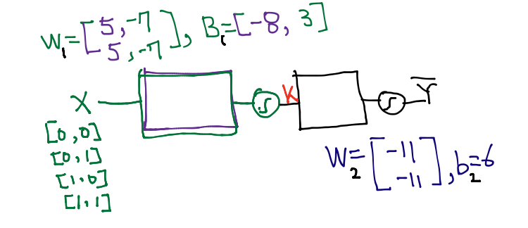
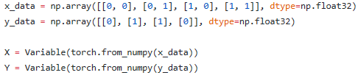
Neural Net
https://github.com/hunkim/DeepLearningZeroToAll/blob/master/pytorch/lab-09-2-xor-nn.py

Slide 8
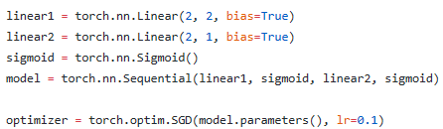
Neural Net
https://github.com/hunkim/DeepLearningZeroToAll/blob/master/pytorch/lab-09-2-xor-nn.py

Slide 9
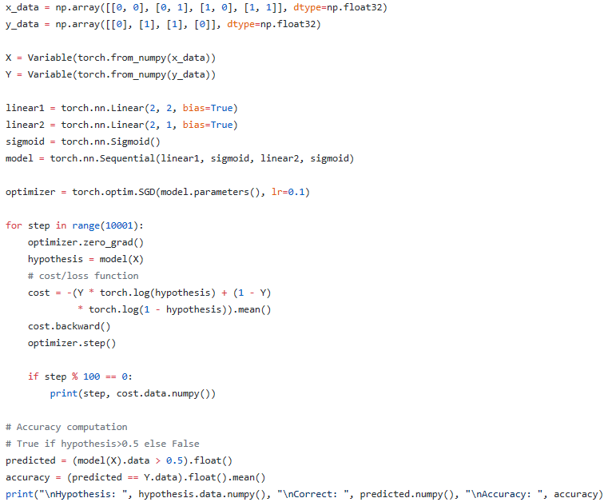
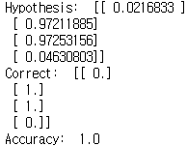
NN for XOR
https://github.com/hunkim/DeepLearningZeroToAll/blob/master/pytorch/lab-09-2-xor-nn.py

Slide 10
Lab 10
NN, Xavier, Dropout
With PyTorch 0.2.0_2
Sung Kim <hunkim+ml@gmail.com>
Code: https://github.com/hunkim/DeepLearningZeroToAll/

